Slide 1

Introduction to Single Board Computer
Dr. K. Vairamani
Department of Electronics
St. Joseph’s College(Autonomous),
Tiruchirappalli-620 002.

Slide 2
Agenda
Introduction to Single board computers
Need for single board computers
Embedded OS
How to choose single board computers
Raspberry pi
Beagle Bone

Slide 3
What are single board computers?
It’s a computer in a single board.
On the board, we have a processor and all other necessary peripherals and circuitry as well.
Onboard RAM, ROM, flash storage, AV ports, Ethernet port, etc. This means that one board is sufficient to act as a full-fledged computer.

Slide 4
Being lightweight and specific, they have found huge application in smartphones, tablets and other consumer products.
Based upon a unique architecture like ARM, Intel x86 or other custom architectures, give whopping performances like 1.2 GHz clock frequency, etc.
When combined with 1GB DDR3 RAM, 2GB Flash storage, HDMI/AV port, USB ports, LAN ports, etc. on the same board, it becomes a single board computer.

Slide 5
Why do we need them?
Portability being one of the major features.
You can carry around a small computer like your smartphone in your pocket everywhere you go! These devices are pretty intuitive to use as well.
They consume less power and energy as compared to traditional computers.
Important feature is being cost effective! Being low cost, these products can reach a much larger part of the community.
This makes them suitable for developer applications as well for development of new apps, testing, debugging, hardware development, hacking etc.

Slide 6
Embedded OS (EOS)
The most important program that runs on a SBC to run other computer programs.
EOS manages computer hardware and software resources and provides common services for computer programs, such as recognizing input from the keyboard, sending output to the display screen, keeping tracking of files and directories on the disk and controlling peripheral devices such as disk drives and printers.
Embedded OS are designed to operate on small machine like PDA’s with less autonomy.

Slide 7
How to choose Single Board Computer?
Most important factors to address in your SBC selection process:
Power
Form Factor
Backward pin compatibility
Processor choice
Memory
Operating system
I/O complement
Performance

Slide 8
Notable single board computers
Raspberry Pi
The Beagles (BeagleBoard, BeagleBoard xM, BeagleBone, BeagleBone Black)
PandaBoard
MK802, MK808
Cubieboard
MarsBoard
Hackberry
Udoo
Intel® has also entered into the Open Source world with its Atom™ processor based MinnowBoard.

Slide 9
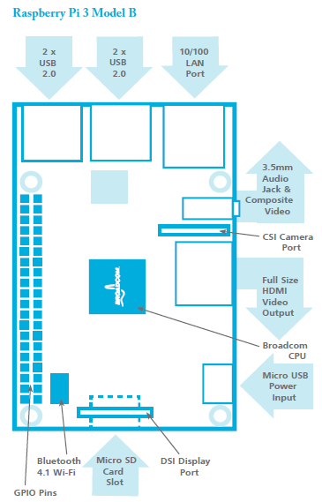
Raspberry Pi

Slide 10
Specification of Raspberry pi 3
Sl.No | :Component | Specification
1 | CPU | 1.2GHz 64-bit Quad-core ARMv8
2 | SoC | Broadcom BCM2837 chipset
3 | GPU | Dual-core VideoCore 4 3D
4 | RAM | 1GB LPDDR2
5 | Network | 802.11 b/g/n Wireless LAN 10/100 Ethernet port (RJ45) Bluetooth 4.1 (Classic & Low Energy)
6 | USB | 4 x USB 2.0 ports
7 | GPIO | 40 header pins
8 | Video | Full HDMI port
9 | Audio | 3.5mm jack and composite video
10 | Camera | Camera Serial Interface (CSI)
11 | Display | Display Serial Interface (DSI)
12 | Storage | Micro SD card slot (push-pull)

Slide 11
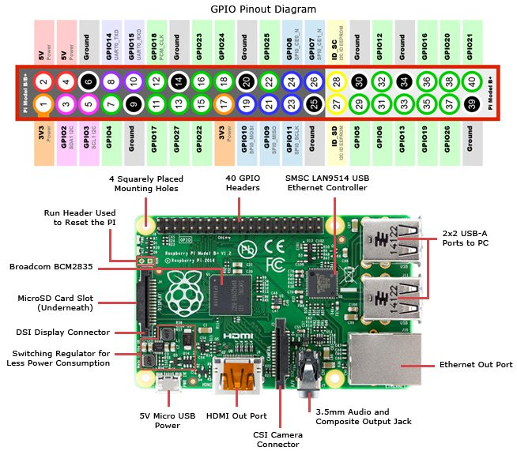

Slide 12
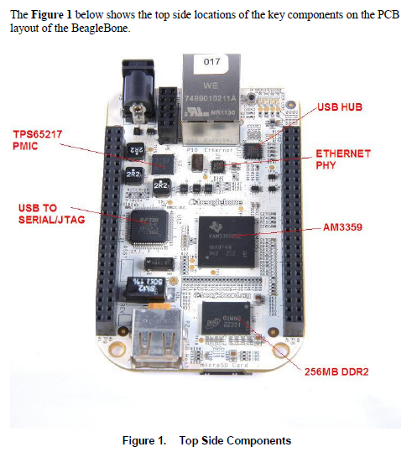
Beagle Bone
Based upon ARM based processors from Texas Instruments, the Beagles are a bunch of single board computers aimed at open source computing.

Slide 14
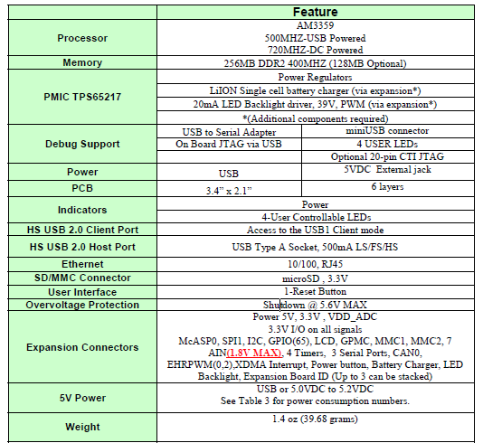
Beagle Bone features

Slide 15
General overview of BeagleBone
Processor
720MHz super-scalar ARM Cortex-A8 (armv7a)
3D graphics accelerator ARM Cortex-M3 for power management
2x Programmable Realtime Unit 32-bit RISC CPUs
Connectivity
USB client: power, debug and device
USB host
Ethernet
2x 46 pin headers 2x I2C, 5x UART, I2S, SPI, CAN, 66x 3.3V GPIO, 7x ADC
Software
4GB microSD card with Angstrom Distribution
Cloud9 IDE on Node.JS with Bonescript library

Slide 16
Thank You

